Slide 1





Stock Pulse
Group-12, 2023
Dhruv Aggarval
Rayyan Khan
Mukesh Kumar
Rohit Karwa
Submitted To: Dr. Dootika Vats

Slide 2


Overview
About Data
Goals
Insights into data
Conclusion

Slide 3





About Data
Historical monthly stock prices of different companies including INFOSYS, JSW Steel, TCS and HDFC Bank
Source
In pursuit of this analysis, we've sourced data from Yahoo Finance, covering the period between August 2016 and September 2023.
Variables
Opening price
Closing price
Highest price
Lowest price
Volumes

Slide 4


Analyze Historical Prizes Of Selected Companies.
Assess trends, fluctuations, and critical performance metrics for these stocks.
GOALS
Evaluate risk in various companies by analyzing metrics such as beta, standard deviation, and volatility.
Compare the performance of different companies.
Analyze stock performance in relation to the overall market trend.

Slide 5


An Insight into the Past

Slide 6
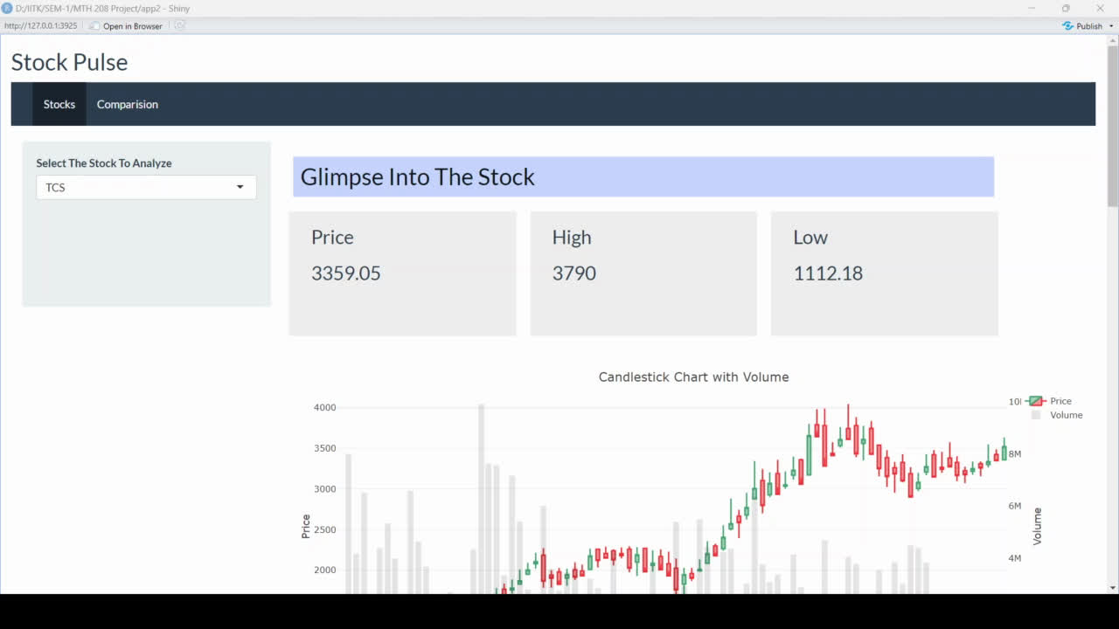

Slide 7


Comparing Various Stocks

Slide 8
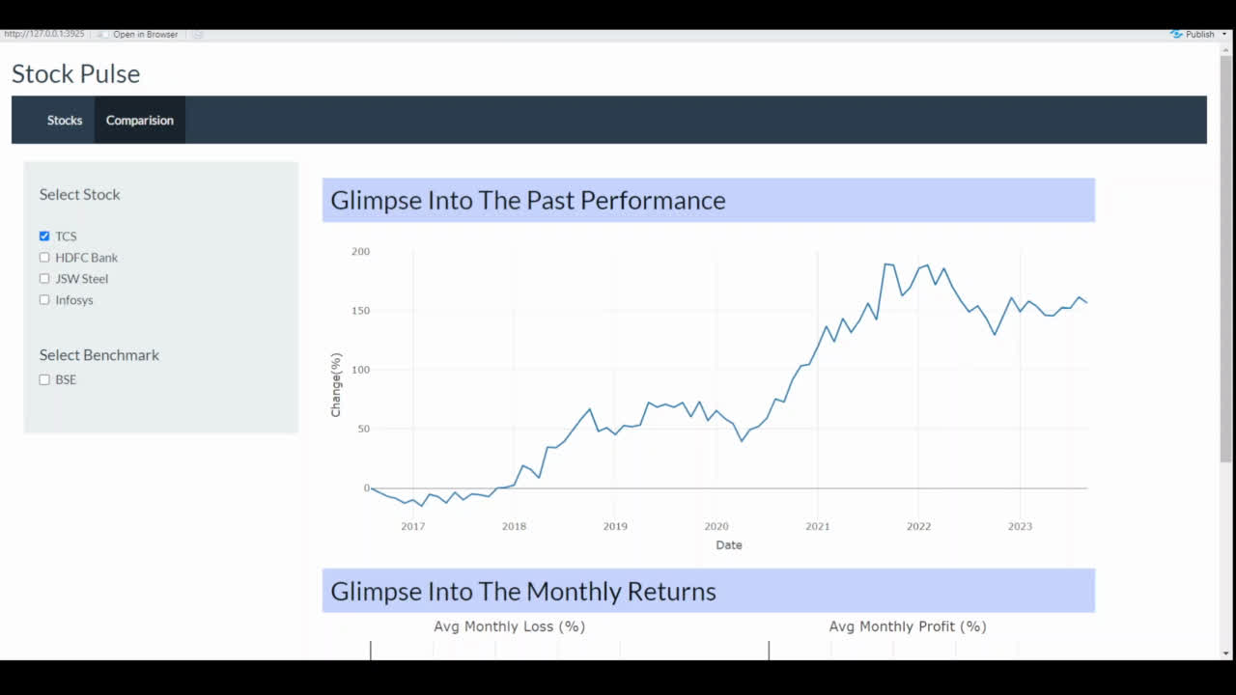

Slide 9

Glimpse into App

Slide 10
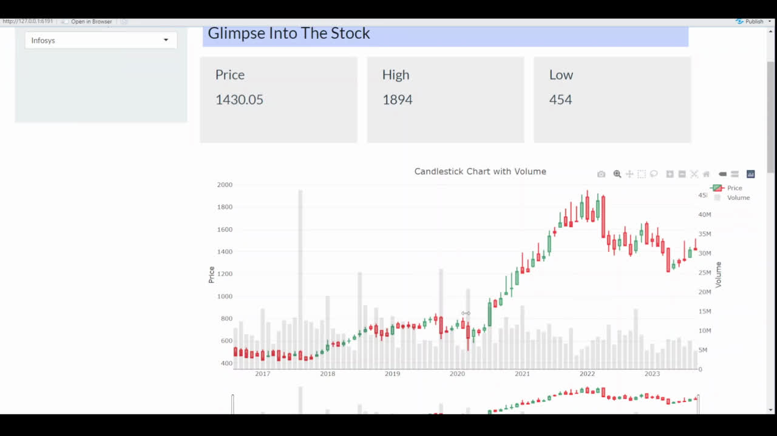

Slide 11
THANK YOU
Calle Cualquiera 123, Cualquier Lugar

